Slide 1
Technical Bootcamp
Week 6
Akshita Verma
Associate Data Engineer

Slide 2
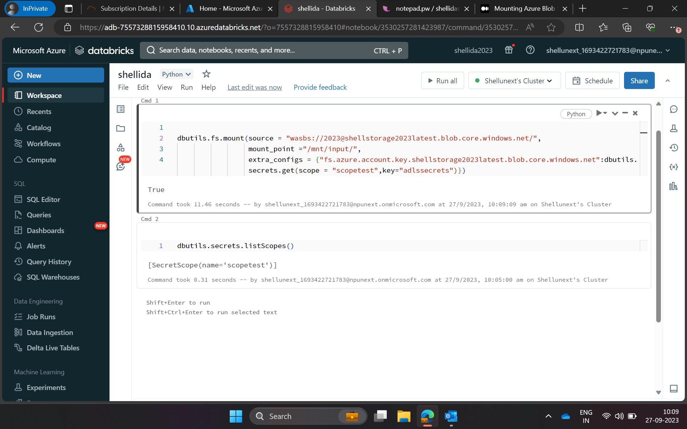
Azure Databricks- Connecting blob storage to Databricks notebook

Slide 3
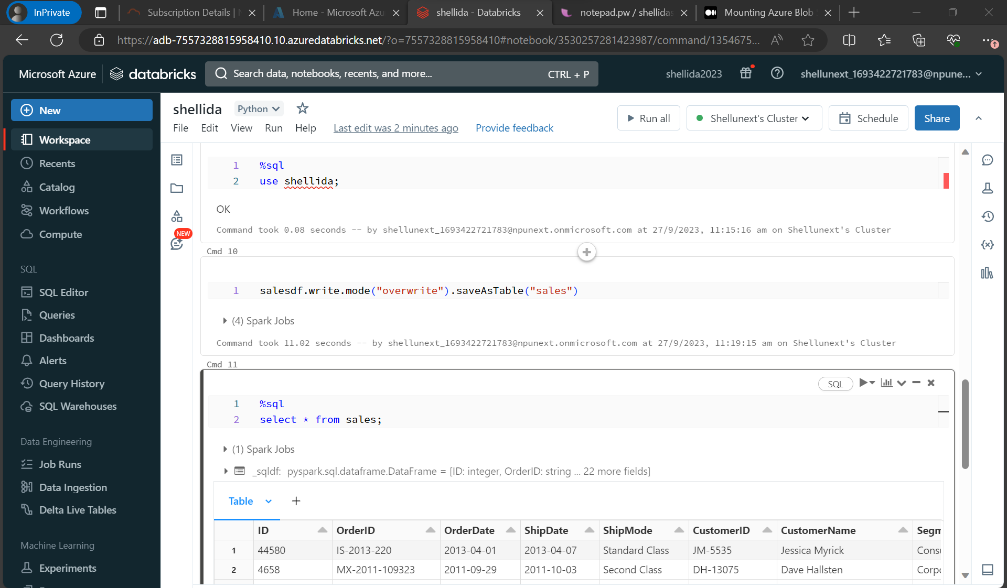
Azure Databricks-Using SQL in databricks

Slide 4
Delta table
Default table format in databricks
Properties
1.Follows ACID
2.Time travel
3.Vacuum
4.Optimum
5.Adaptive Query execution

Slide 5
Docker
Docker is a set of platforms as a service (PaaS) products that use the Operating system level virtualization to deliver software in packages called containers.
Containers are isolated from one another and bundle their own software, libraries, and configuration files; they can communicate with each other through well-defined channels.
All containers are run by a single operating system kernel and therefore use fewer resources than a virtual machine.

Slide 6
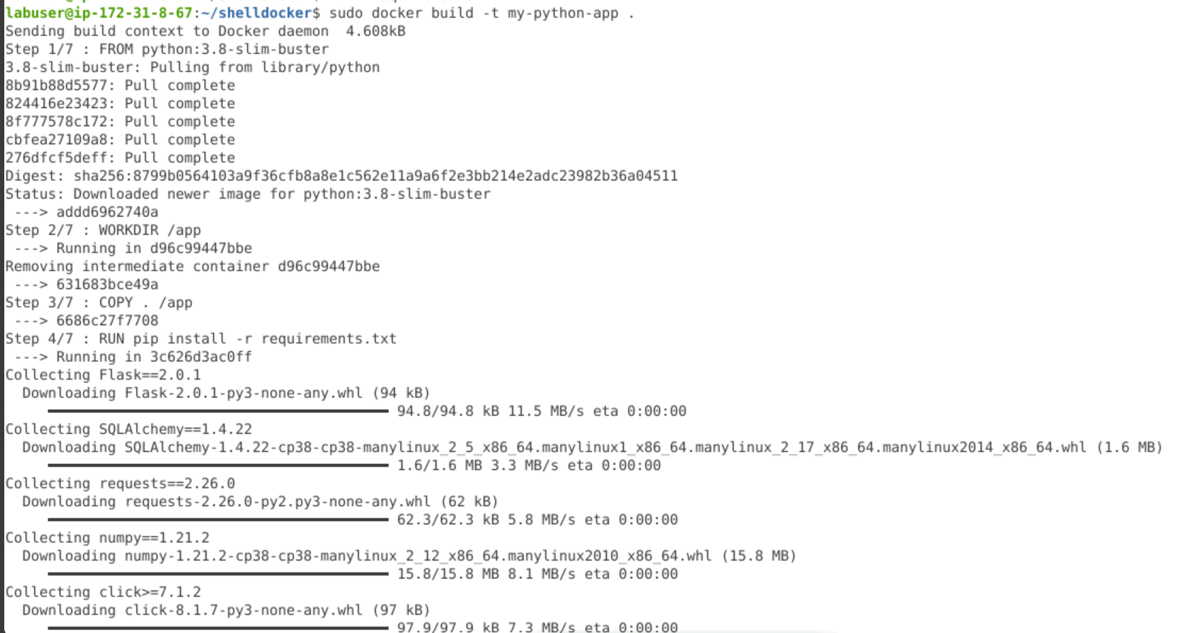
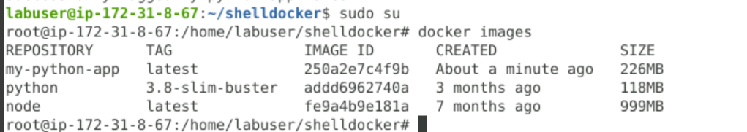
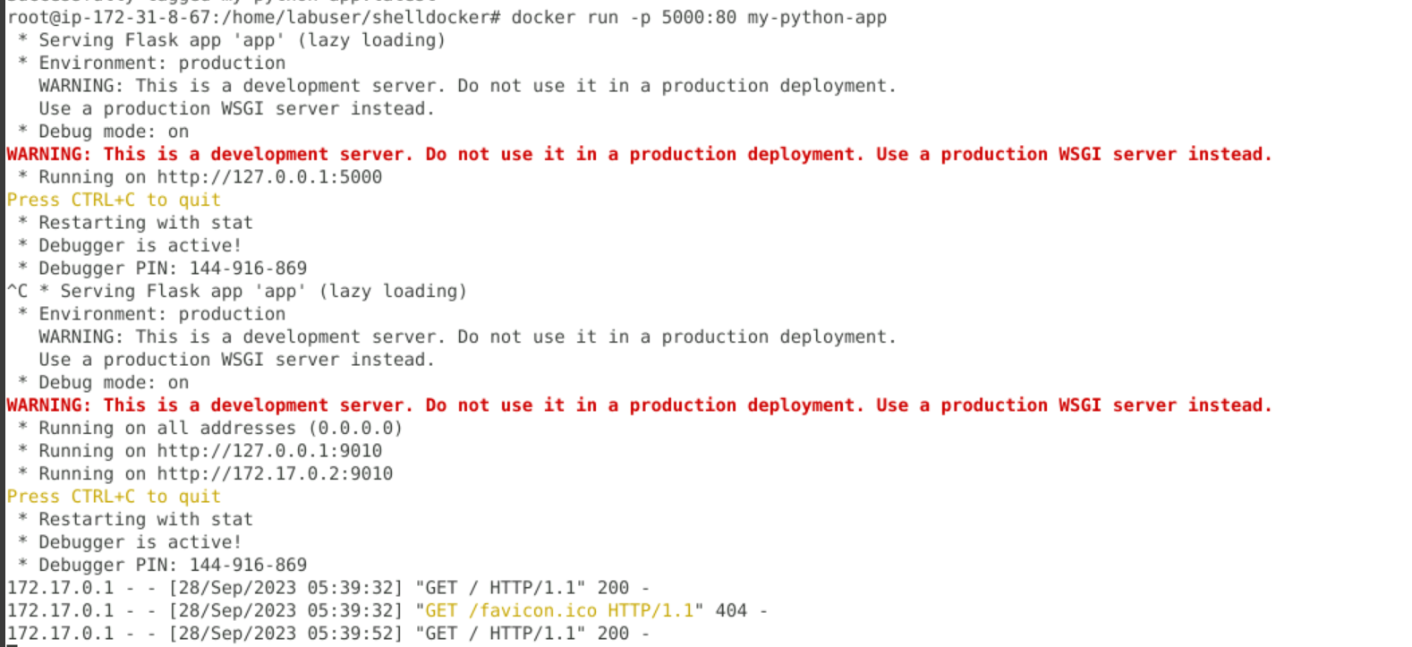
Docker commands – Hands On

Slide 7
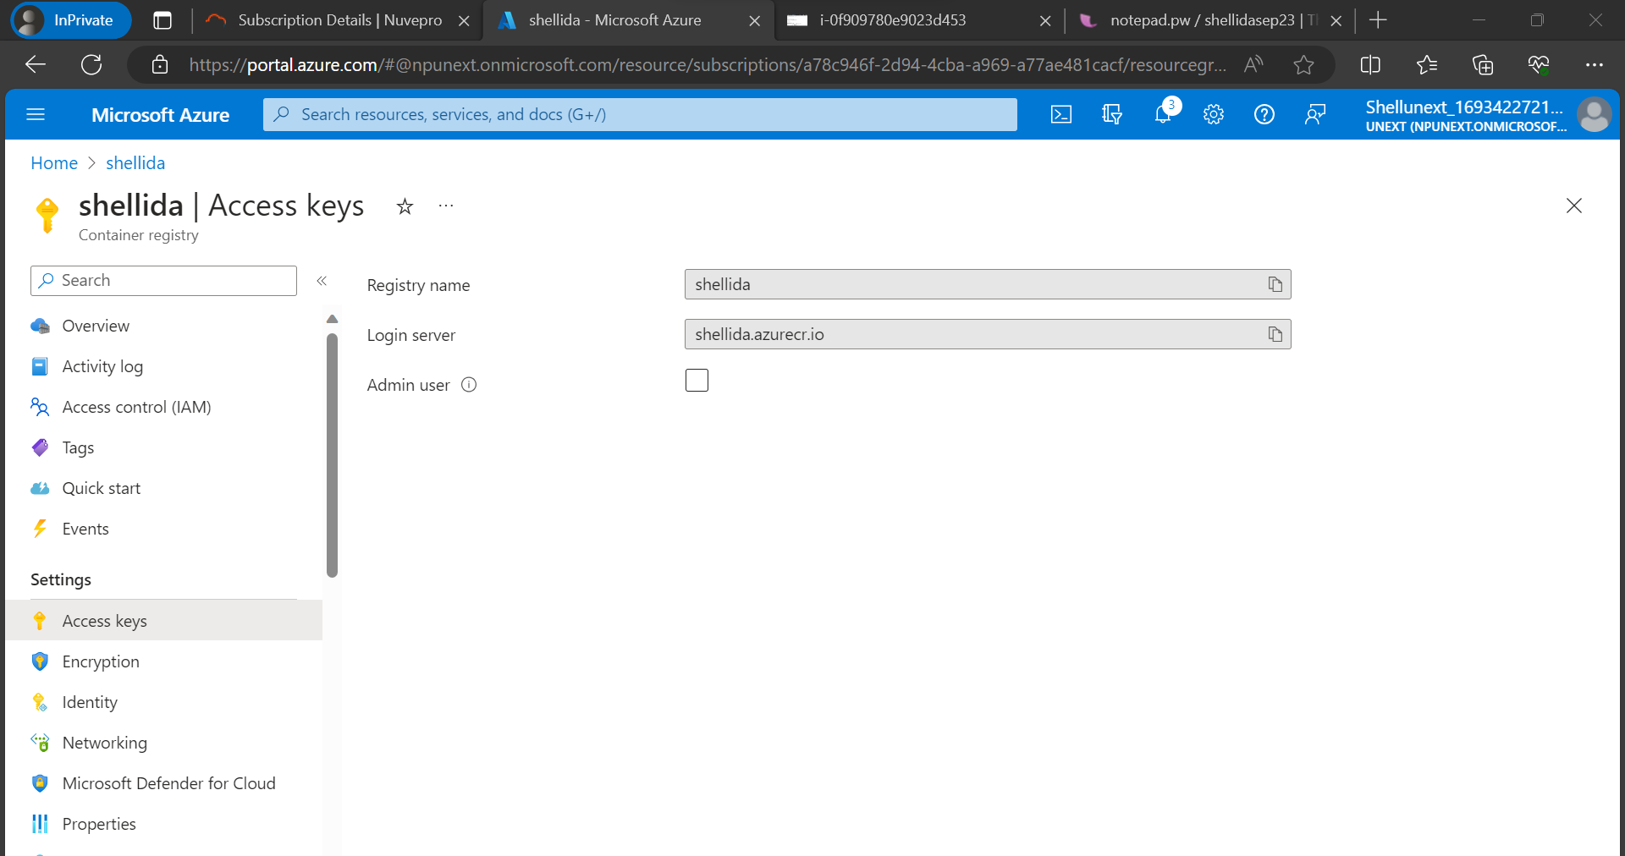
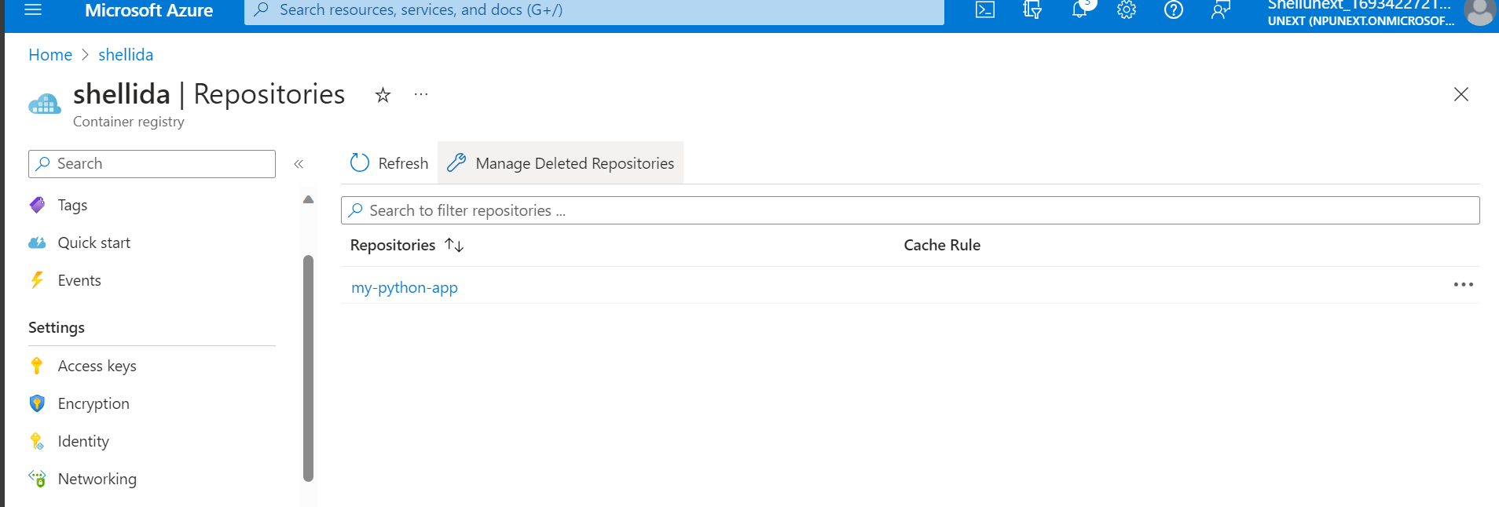
Container registry on Azure

Slide 8
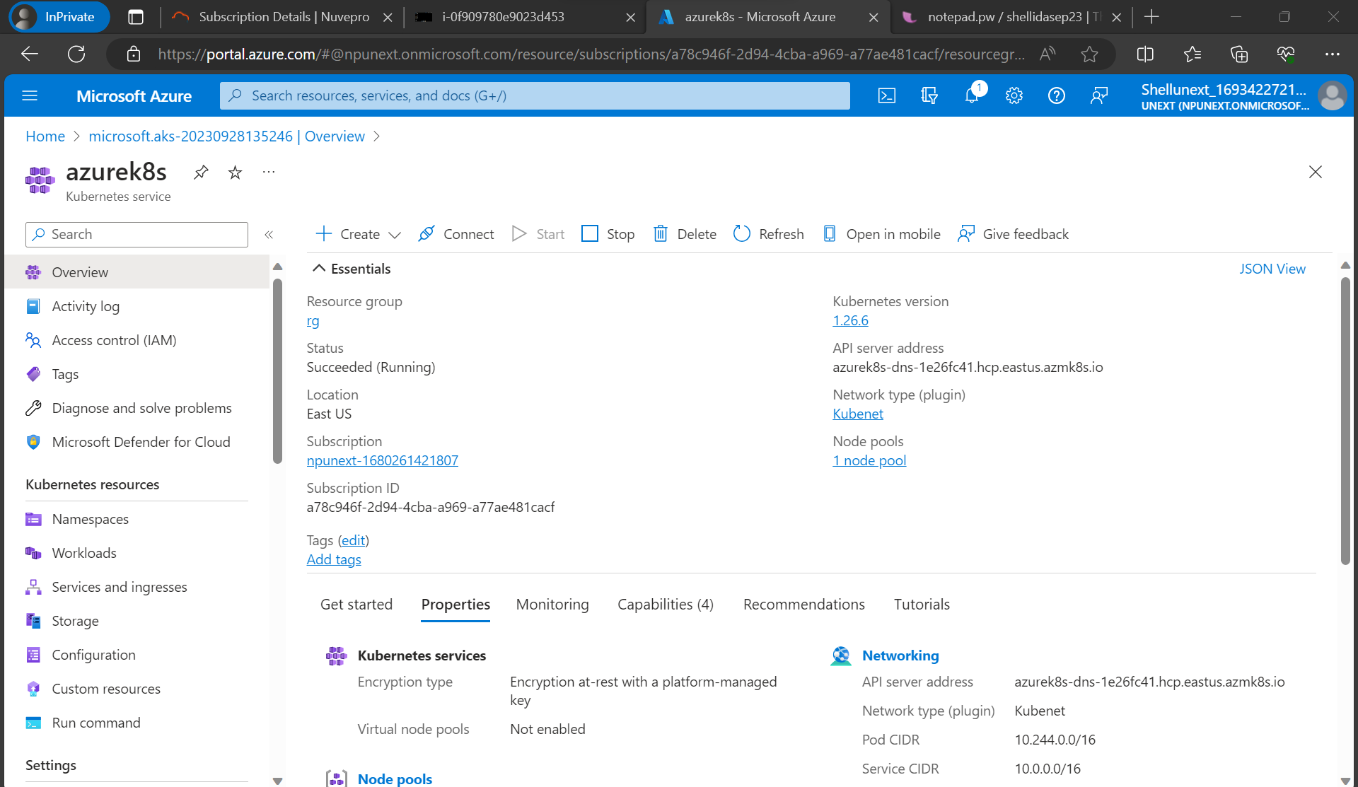
Kubernetes

